Slide 1
Testing in an agile world
The evolution from Waterfall to Agile
The objective of testing is still to find bugs, not prove that the application works.

Slide 2
Product Owners perspective Pretend that the project is “launching a new ferry”
Is the application fully tested?
Watertight?
Propulsion working?
Steering working?
Braking working?
How do we know?
Statistics / Facts
Application map (APIs / endpoints, hyperlinks, etc.)
Tested all requirements (requirement traceability matrix RTM)

Slide 3
Testing phases sometimes more or less sometimes different names

Slide 4
Traditional Phase Descriptions
Unit – The testing of the code in a stand alone format, typically “does it run?”
This should include all of the validation tests i.e. “is the data numeric?” or “is it a valid date?”
Simple input / output testing
Functional – Does the application handle all of the valid data permutations expected? Does the application generate the expected output?
Interface (API) – do the inbound and outbound interfaces respond correctly?
Performance – At what volume of data does system performance degrade? Is it acceptable? I.e. for a payroll system, how many employees can we calculate pay on before it takes too long?
Load – How many concurrent user sessions, doing expected tasks can the application handle before performance degrades? Is this acceptable?

Slide 5
Traditional Phase Descriptions (cont.)
Security – Can the right users access the right parts of the application and does the application stop the “wrong” people from accessing things they shouldn’t?
Parallel – If you are replacing an existing application, is it valuable to compare the output from the existing application with the new application? Ie, an accounts payable replacement. When processing the same input through both systems, do you get the same output (with expected variances)?
Regression – as you make changes to any part of the application, you must run a set of tests through the entire application to ensure that you have not inadvertently broken it elsewhere
Smoke – a light level test in the Prod environment to ensure that the migration worked and all components are functioning.

Slide 6
Traditional phase Descriptions (cont.)
UAT – User Acceptance Testing
In Waterfall, this refers to the final test drive of the system before going live. By this point it is expected that there are no bugs left to discover, so this is often a formality
In Agile, this makes up the bulk of the functional testing and relies on the user base to functionally test the application. Since each sprint is only 2 - 3 weeks in duration, the amount of functionality that can be added and therefore tested should be achievable.

Slide 7
Moving to Agile
At a very high level, the stakeholders expect all of the traditional testing to happen. Just FASTER.
The only way for this to happen is to implement automated testing wherever possible.
Approaches:
As we notice things breaking, we add automated testing (Boeing Max 8 example?)
Map out all test points and build tests for them in a planned approach

Slide 8
Testing Effort estimated

Slide 9
Manual vs automated testing
A test (generally) requires a script
A list of individual steps with an expected outcome
Manual tests are executed … well manually
Each step is read from a list and executed
The results are compared to the expected result as listed
The success or failure of the outcome is recorded … manually
Automated tests require that the steps be “programmed”
The effort to build automated scripts is more than what is required for manual (even with record and playback)
Each step is executed and the results compared and outcome recorded programmatically

Slide 10
Manual vs automated testing
Any test consists of:
Instruction / step (do this) – click on the “Catalog” button
Expected result / outcome (should get this) – the catalog is displayed
Result (did we get what we expected?) – Pass / Fail
Manually, you would list these and execute them individually
Automated, you would use a tool to program the computer to execute the instruction, then verify the outcome and record the result. Then move onto the next step, IF it passed.
UI – valid users / valid paths / valid input combinations (permutations)
Data driven / parameterized tests

Slide 11
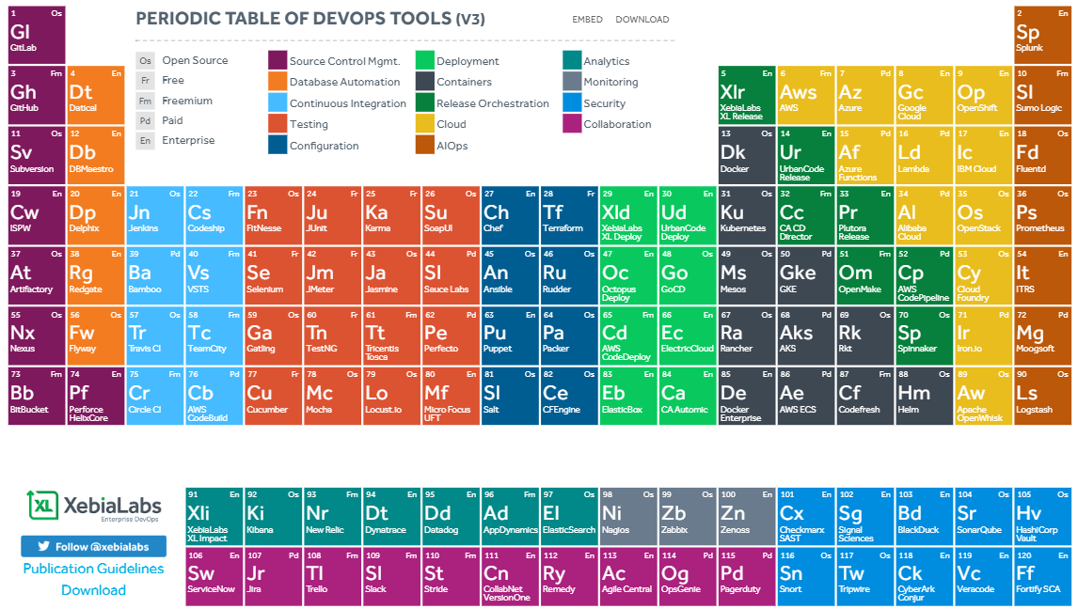
DevOps tools – this is a very useful guide https://xebialabs.com/periodic-table-of-devops-tools/

Slide 12
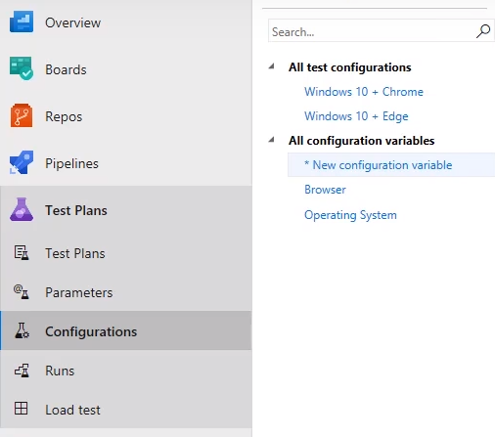
Manual testing example (Azure)

Slide 13
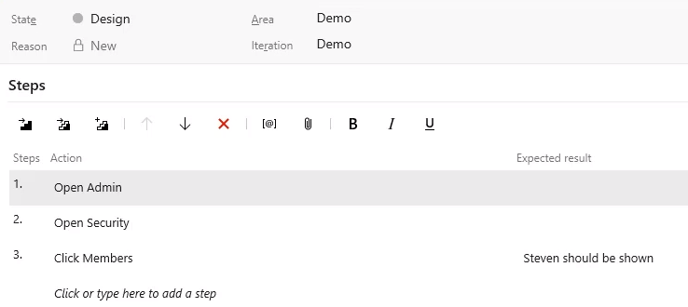
Testing Steps

Slide 14
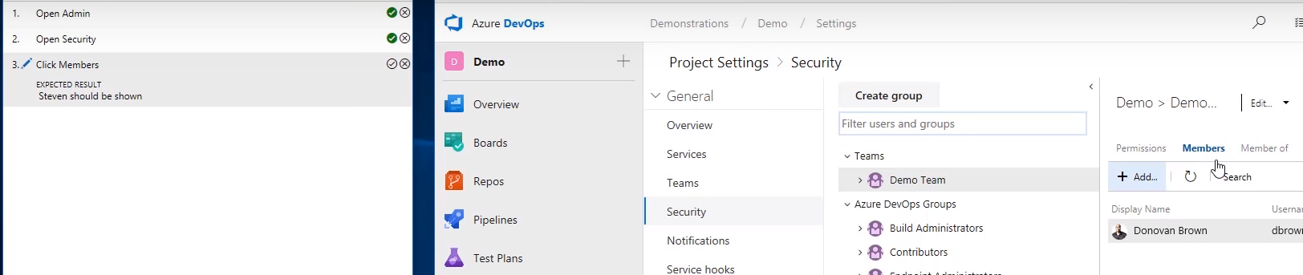
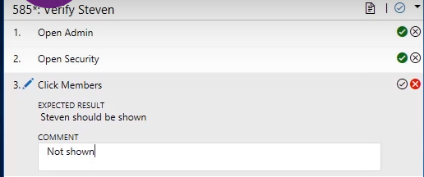
Manual testing
After each step, the user will manually click the pass/fail button here

Slide 15
Testing Steps
To automate these same steps you would use a tool like Selenium or UFT to execute each step in whatever configuration and verify the results.

Slide 16
Manual vs automated testing
Whether manual or automated, you should use a collaboration tool to record the outcomes
When and if you use manual vs automated varies
Tools – what do you have? How expensive are they? Skill set
Frequency of use – if you need to prioritize, look at effort saved and how often
“trust” – does your organization trust change? “we have always done it this way”
Volume – how many variations of each test do you need to run?

Slide 17
Manual vs automated testing
Automation benefits:
Repetitive tasks
Same test with parameterized data input (functional)
Same test with different browsers (Integration / regression)
Same tests for consecutive releases (regression)
Same test for multiple users (Load)
Large/batch data sets (Functional)
Data entry (fast and accurate)
Validation of results (why look at the ones that are correct?)

Slide 18
Agile testing methods There are various agile testing methods as follows:
Behavior Driven Development (BDD)
Acceptance Test Driven Development (ATDD)
Exploratory Testing
You can use all or a combination of these.

Slide 19
Behavior Driven Development (BDD)
is an approach that consists on defining the behavior of a feature through examples in plain text. These examples are defined before the development starts and are used as acceptance criteria. They are part of the definition of done. The examples are called Scenarios which are written in a special format called Gherkin Given/When/Then syntax. The scenarios hold information on how a given feature should behave in different situations with different input parameters. These are called “Executable Specifications” as it comprises of both specification and inputs to the automated tests.

Slide 20
BDD Example
Given the customer has logged into their account
And the balance is shown to be $100
When the customer transfers $75 to their savings account
Then the new balance should be $25

Slide 21
Acceptance Test Driven Development (ATDD)
ATDD focuses on involving team members with different perspectives such as the customer, developer, and tester. Three Amigos meetings are held to formulate acceptance tests incorporating perspectives of the customer, development, and testing. The customer is focused on the problem that is to be solved, the development is focused on how the problem will be solved whereas the testing is focused on what could go wrong. The acceptance tests are a representation of the user’s point of view and it describes how the system will function. It also helps to verify that the system functions as it is supposed to.

Slide 22
ATDD Example
Scenario: Restricted pages require login
Given the user has not logged in
When the user tries to access a restricted page
Then the user should be redirected to the login page

Slide 23
Exploratory Testing
In this type of testing, the test design and test execution phase go hand in hand. Exploratory testing emphasizes working software over comprehensive documentation. The testers identify the functionality of an application by exploring the application. They try to learn the application, and design & execute the test plans according to their findings.

Slide 24
Exploratory Testing
By exploring the application, you will uncover the unique, hard-to-find bugs you didn’t know existed. Scripted testing such as automated testing cannot do this because it follows predefined instructions. Anything outside of this scope will be missed.
The collective power of more heads is better than one. Diversity is vital for exploratory testing to succeed. The more diverse the group of exploratory testers – from developers to product managers, UX designers, business analysts and support engineers –, the better the results should be.

Slide 25
Exploratory Testing
A common misconception about exploratory testing is that it slows down the development cycle. This is untrue. Unlike other testing methods, there is no need to invest time in authoring, preparing and approving test cases for exploratory testing.
Exploratory testing is a vital component of any successful Agile team’s testing strategy. An exploratory tester asks questions of the application that scripted testing can’t. This helps the development team write better code to improve the application’s quality.

Slide 26
Exploratory Testing
A potential pitfall of exploratory testing is that the testers unknowingly duplicate each other’s tests and totally miss other test areas. They all do the “happy path” and don’t test the extreme oddballs.

Slide 27
What tests should you automate?
Test automation fits with the principles of Agile teams. Communication and feedback from the QA team should determine when automation should be used. For example, if a tester is repeating the same test on multiple occasions in a short period of time, it should be a candidate for automation. Highly repetitive, laborious testing is where automation works best.
As an Agile team, it’s important to know when not to use automated testing too. One-time tasks generally shouldn't be automated. Given how long it takes to execute manually vs. the effort required to write the automated script, this typically isn't an efficient use of time, nor is it cost-effective.

Slide 28
Be smart about designing and writing test scripts
If you can build your scripts “modularly” you can save extensive amounts of time. I.e. “sign into the application” or “Navigate to X”, since this code will be used by most if not all scripts, build them once. This should be second nature to most OOP developers, not so much for those coming from batch processing environments.
For BC Ferries we wrote 23 scripts (modules) to perform 30000 test scenarios. This allowed us to combine the modules in different orders and feed them from an external data table to achieve our objective.

Slide 29
Be smart about designing and writing test scripts
Validation of results:
For online applications, this is fairly straightforward. When you do X, you should get Y
For batch applications, this is not always so easy, however, for each set of data, you should be able to calculate an expected result, or else it is impossible to prove that the test passed or failed.
Store the expected result(s) for each entry
Extract the results from the DB after the batch process
Compare the batch of expected to the actual and flag the differences
You may have to think outside of the test tool to do this. Don’t let the tools constrain you!

Slide 30
Be smart about testing
Tests take time. Running all tests, in every deployment stage can create time-consuming redundancy. The trick is to use testing time wisely to achieve the highest degree of quality possible. Thus, test planners will do well to work with DevOps personnel to determine the best places in the DevOps pipeline to conduct testing according to the purpose of the pipeline and the purpose of the testing. Thorough testing is critical to a successful DevOps pipeline. So is testing at the right time, in the right place. Segmenting automated testing properly along the DevOps pipeline will go a long way toward implementing a deployment process that is both efficient and reliable.

Slide 31
Other considerations
Data prep / load / obfuscation (Factory Boy / Faker)
Data refresh (some tests might contaminate the data for future tests)
Requirements Traceability
Audits – do you have audit requirements to prove that tests ran correctly?
Test speed – volume / time allotted in the sprint
Test budget / timeline – planned vs ad hoc, # of resources, available tools
Etc.

Slide 32
batch vs interactive applications
Batch – means processing data once a certain condition is met.
Date/time – ie payroll is processed every two weeks
Volume – ie when Amazon has a truck full of packages, they are dispatched to the airport.
Generally the number of test scenarios is quite high 100’s – 1000’s
Inputs to expected results is not always a 1:1 situation. Ie time entry to net pay
Interactive (online, Web, etc.)
Generally a 1:1 relation of input to result
Results are immediate

Slide 33
Interactive / online vs batch application testing
Payroll processing
It would not make sense for the payroll process to calculate your pay every time you “clock out” from an activity, even as time keeping systems become real-time the processing behind the scenes is a batch process. We don’t get paid at lunch time and again at the end of the day.
Therefore the testing for this must test the result of the entire batch of transactions
Web applications
The “catalog button” appears and works when you click on it.
You can locate item “X” in the catalog

Slide 34
Interactive / online vs batch application testing
Regardless of how we see the world, there will still be batch processes
Ie Amazon.
You go online search for you earbuds, find them purchase them and then they show up at your door.
The online portion is immediate but behind the scenes, do they dispatch a package from the depot to your home each time you click the checkout? No, the drivers pick up a “batch” of packages which are sorted into regions for delivery to make it more efficient. There is an application to manage this process.

Slide 35
Are all Applications candidates for agile?
Keep in mind that Agile is based on Continuous Integration/Continuous Delivery (Deployment) (CI/CD)
Is the Minimum Viable Product (MVP) is the entire fully functional application?
Can the MVP be added to in a rational manner?
Are we continually upgrading and enhancing an existing application?

Slide 36
SO we have an agile project
Agile testing is a continuous process rather than being sequential.
The developers, business analysts and “users” test the application.
The business team is involved in each iteration in agile testing & continuous feedback shortens the time of feedback response
All the defects which are raised by the agile team are fixed within the same iteration

